Slide 1

Quick Tales
Vegan gourmet

Slide 2





TABLE OF CONTENTS
ABOUT US
MARKET ANALYSIS
SWOT & Enviornmental scan
Pricing strategy
Promotional strategy
Introduction to Quick tales restaurant and products.
The details of our place strategy and our target market.
Analysis of our market competitors and brand image.
The pricing strategy for our products and food menu.
Analysis on our go-to-market strategies and promotinal plan.

Slide 3




OUR COMPANY
Quick tales is a vegan and health-oriented restaurant. Made specifically for people who are in a hurry but don’t want to compromise on healthy eating. With budget-friendly food items and savoury taste, our customers will find a perfect one-stop eating solution. As our company says, “Quick tales...The food that Earth recommends.”

Slide 4

ABOUT THE PRODUCT
Our products are Meat and dairy free made specifically keeping health and Enviornment in mind. Our ambiance is lively and menu designed to quickly serve and make our customers happy. With eco-friendly products and a well designed restaurant we would serve our customers an experience they won’t forget. The menu has variation of unique food combine together at one place with healthy twist.

Slide 5
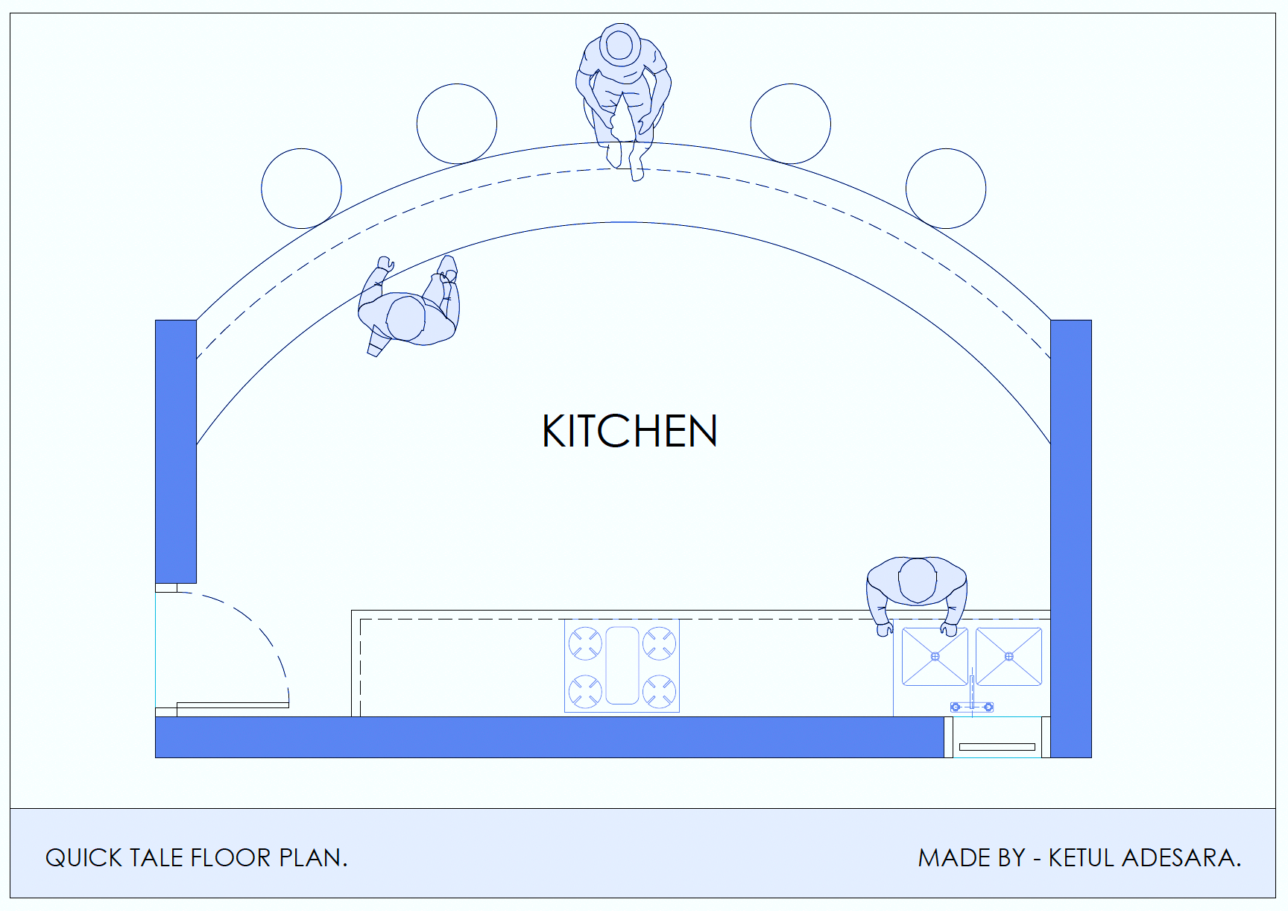

Place strategy
Desired Campus Location
Restaurant location is at base level and
Near to food service area.
Due to its unique look, it stands out.
Layout and signage
The restaurant shows our brand colors and
has neon logo.
The area is spacious so its easy to manage
everything easily.
Non-store distribution channel
The restaurant shows our web application
on both side of the table for ease of use and
fast paced orders.
Out of campus & local delivery services within described location.
Floor plan for Quick tales

Slide 6


Target AUDIENCES
age
Behaviouristics
17-25
35-45
1st
45-55
GENDER
2nd
3rd
People living in Kitchener area & suburbs,
Student & staff of Conestoga College.
AGE
People looking for quick & healthy food.
Vegan & gluten free, suited for everyday staple food.
Affordable pricing for target market, promotions & offers for loyalty.
Our target audience is Extrovert in nature and often socially active, they like to participate in events and hang out. Usually having lack of time and busy. They are technologically advanced and knows the usage of internet and devices.

Slide 7
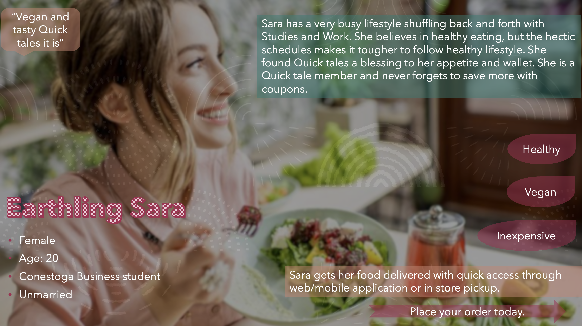

MARKET Positioning
Positioning
We stand on top of value and healthy products among our competitors. We serve quick and healthy food for our target market. The brand image and positioning can be recognized by it’s strong market place that it will establish among it’s competitors.

Slide 8
SWOT ANALYSIS
Strengths
Threats
Plant based menu items.
Customer service and ambiance.
Social media marketing to our target markets.
Reasonable pricing.
Well established food joints in the Conestoga campus.
Competetively priced food by competitors.
Food joints with same operating model as Quick tales.
Weakness
Opportunities
Limited seating capacity.
Noise levels.
Relatively newer establishment.
Increasing demand for contactless payment and delivery.
Clean, Vegan, Gluten free food options.

Slide 9


Enviornmental scan
Competitive forces
Socio-cultural forces
Technological Forces
Direct competitors: Indirect Competitors:
Smoke’s Poutinerie Pizza Pizza
Create Station Bento sushi station
Subway Grill & co. Soup.
On-The-Go.
Increasing demand for plant-based food.
Decrease in demand for meat consumption.
Increase in use of AR based applications
Like facial recognition to place orders.
Increase in demand for curb side pick-up.
Increase in demand for contactless payments.
Regulatory Forces
Economic forces
Demographic Forces
Quick tale will abide guidelines by:
Regulation Guidelines.
The food and drug act.
Health Canada.
Our business faces additional operational costs for sanitization.
50% workforce capacity.
Weakened supply chain.
Target market age group of 17-25 years old.
The average income of this group is
about $29,738 / year which is $15.25 / hour.
Gender: Male and Female.

Slide 10
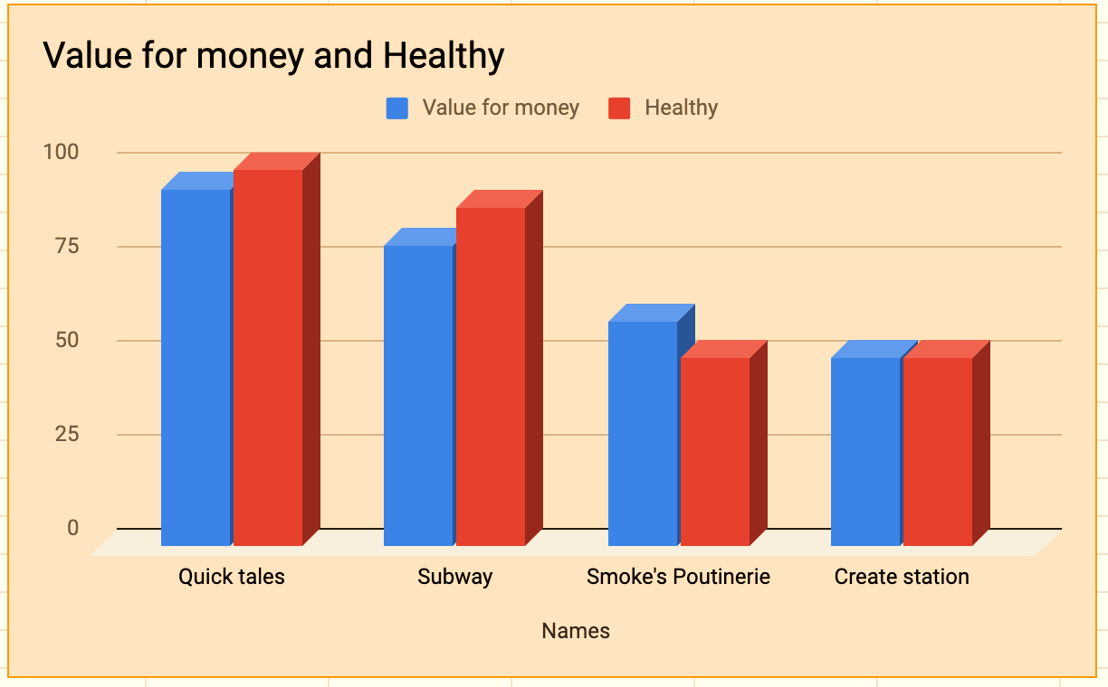
Price strategy
Menu
Our restaurant delivers value for money food items.
Competition
There is many competitors in campus and target market but we stand top on healthy and value for money products.
Constraints
Less profit in initial stage but estimated good customer base and exposure, later generating profit.

Slide 11
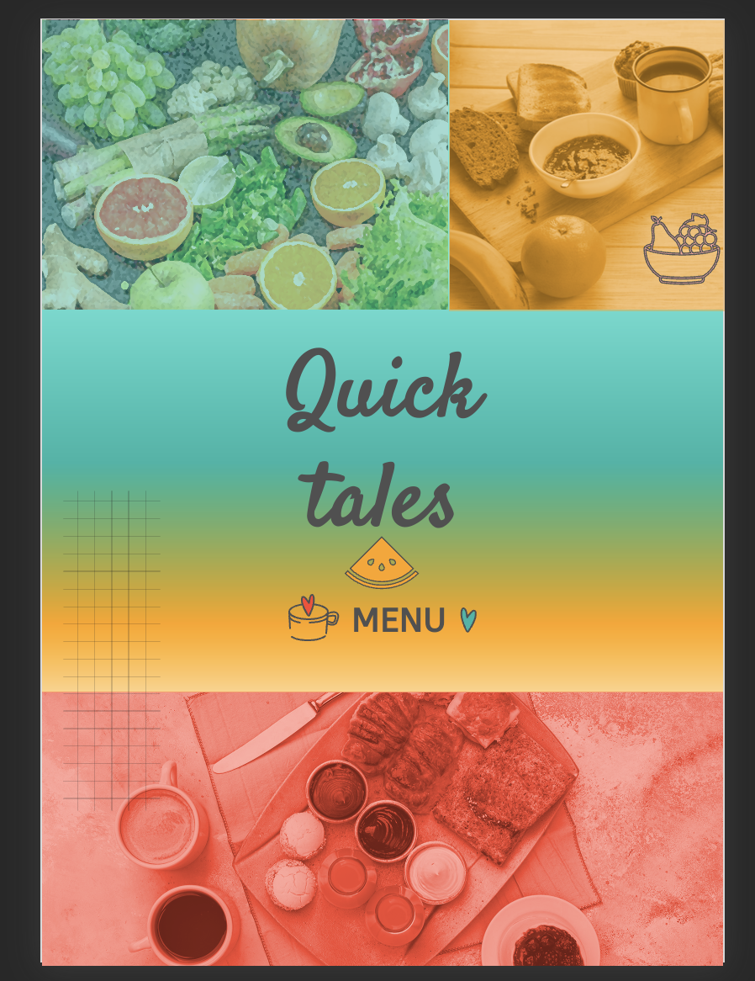

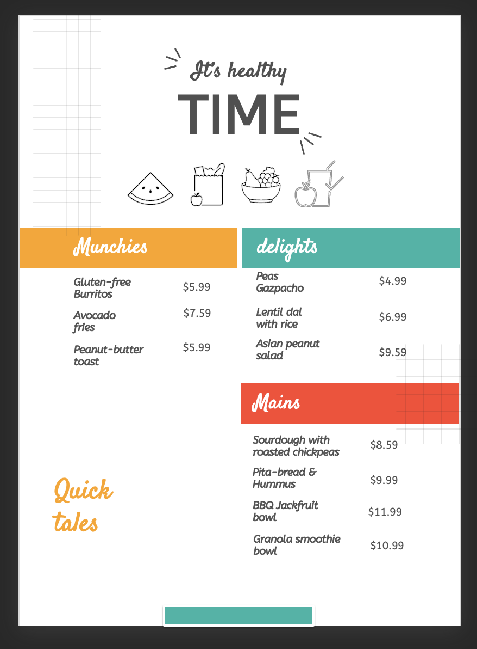
menu

Slide 12
PROMOTION
MULTIMEDIA
PRESS & local
APP
We will advertise our products through social-media and geo-targeted advertisements.
Timely newspaper ads and blogs on website by foodies. Organizing food fest and direct responses.
This will help us connect to our customer and placing orders easily. Engage our loyal customers with promotions.

Slide 13

Advertising
CHANNEL
BUDGET
$46,200
Multimedia
Application
Quick tale membership & awareness
Placing orders easily and to execute promotions and coupons online.
To make loyal customers and have a digital presence.
Social –media and advertising
Advertise our products to target market with paid promotional social-media posts by influencers, geo-targeted ads, google platform ads. Inviting bloggers to blog and sending raffle for our members and loyal customers.

Slide 14

Local market strategies
CHANNEL
$50,000
BUDGET
Local promotions.
Attractions
Organizing food-fest & local game menu distribution.
Sending mails of promotional coupons to attract consumers.
Great IMC launch with multiple promotions.
Survey & Public relations
We will conduct local & online surveys in exchange of reward and maintain a very well public relation campaign to establish our restaurant as a customer based brand.

Slide 15

THANK you!
quicktales@conestoga.com
+123 456 7890
Quicktales.com

Slide 16
CREDITS
Presentation by Ketul Adesara
Data by:
Product strategy: Aastha Sarangal
Place strategy: Sohil Desai
SWOT & Enviornmental scan: Chetana Gururaj
Target Market and positioning: Simranjeet Kaur
Price strategy & Promotional strategy: Ketul Adesara.

